Slide 1
Design of single-sided HPF to measure Vphase and Vneutral
7th October, 2014
Manoj Gulati

Slide 2
Connection Diagram
Mains
Power Supply
Phase
Appliance Under Test
Earth
Neutral
0.1uF
Node A
R
Node B
Vrms = 230V
50 Hz
Vp = 326V
C
100
To MDO CH-1
70
R
70
Vphase
R
0.1uF
Node A
Node B
R
Vrms = 230V
50 Hz
Vp = 326V
C
100
To MDO CH-2
70
R
70
R
Vneutral

Slide 3
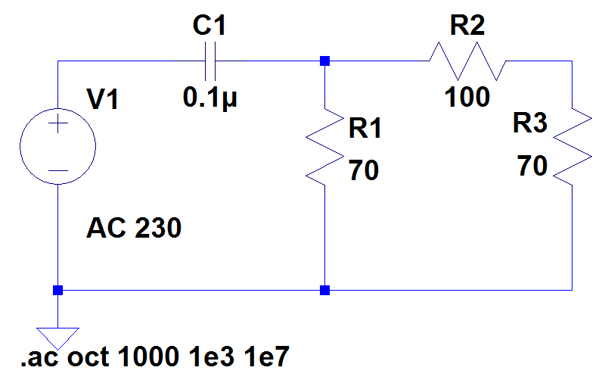
Filter Parameters (Calculated and Measured)
Single-ended
Balanced Pi structure (to match input and output R value to 50 ohm)
(Calculated and Measured)
Output Impedance = 50 Ohm (Calculated and Measured)
Equivalent R = 50 Ohms
C = 0.1uF
Fc = 31.84 kHz (Calculated)
V(Node A) = 0.7149V (Calculated)
V(Node B) = 0.2944V (Calculated)

Slide 4
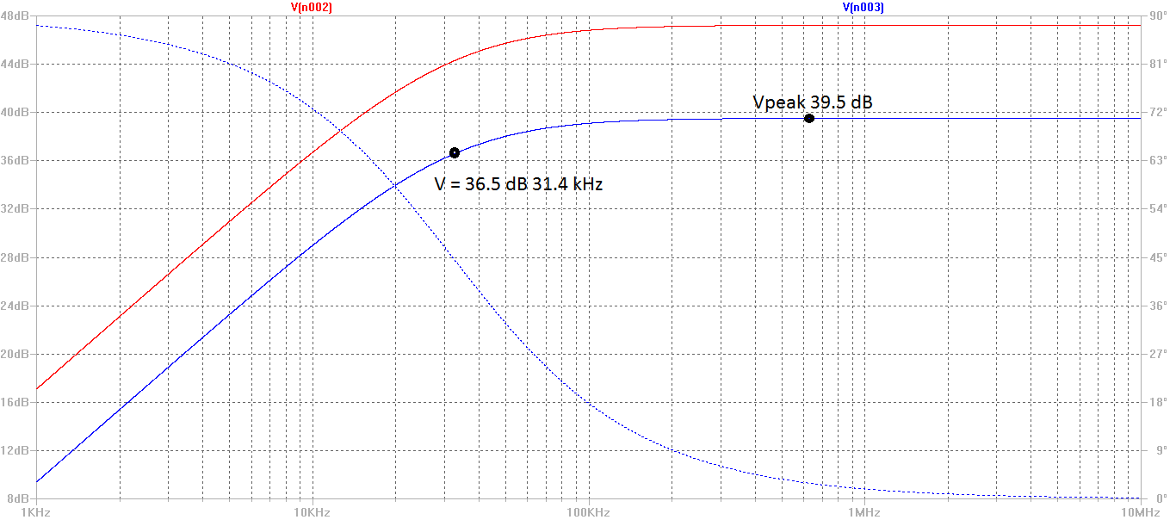
Simulation Results

Slide 5
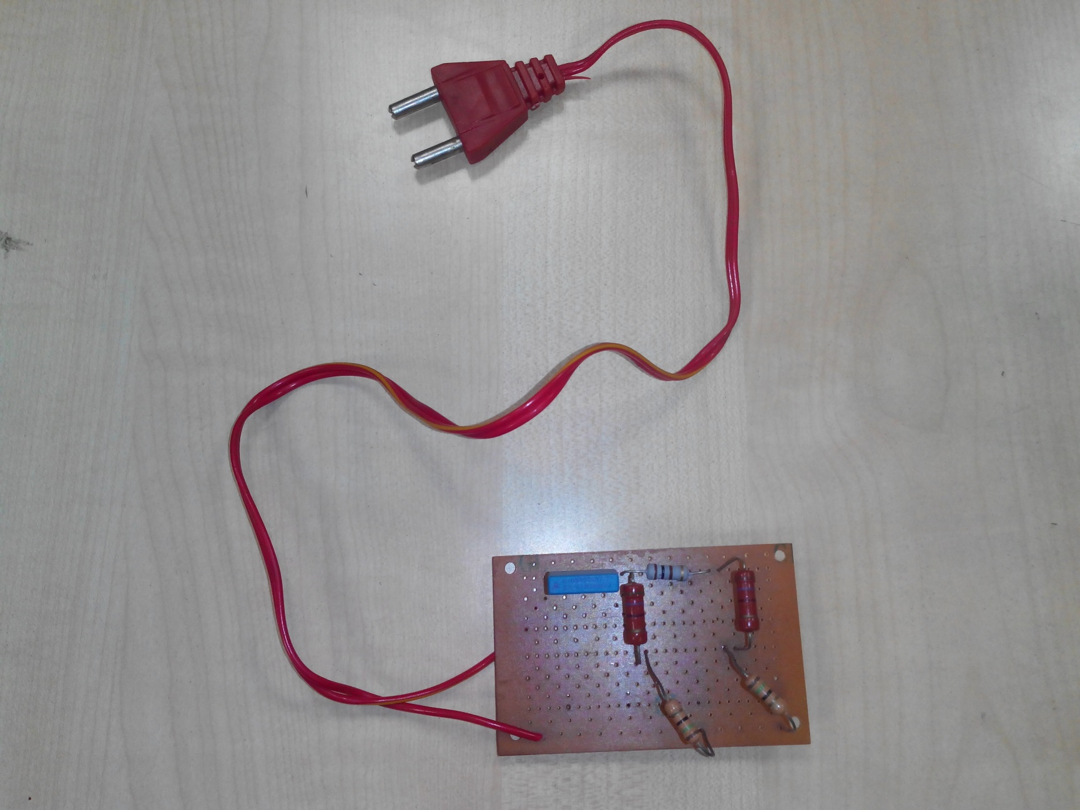
Circuit Prototype

Slide 6
Sensing System: Tektronix MDO 4104-06
4 Analog Input Channels
1 spectrum analyzer channel (50 kHz to 3 GHz)
In-built features like FFT Spectrum analysis and Spectrogram.
1 GHz Bandwidth
Up to 2.5GSa/s sampling rate
No. of points: 20000 max (Time domain)
Active Probing (Optional Adapter TPA-N-VPI)
12dB Gain from (9kHz-6GHz) also meant for EMI measurements
Data export: USB storage similar to signal analyzer.

Slide 7
Task for next week (14-10-2014)
Make two such circuits on a good quality PCB board.
Get Vphase and Vneutral data with a single appliance from MDO.
Compute Vcm and Vdm using Vphase and Vneutral data in MATLAB and compute FFT for this.
Match Vdm results with previous results from EMI paper.

